Slide 1
Diafiltration to Capture Multicomponent Effects
Jonathan Aubuchon Ouimet, Laurianne Lair, Xinhong Liu, Alexander Dowling, William Phillip

Slide 2
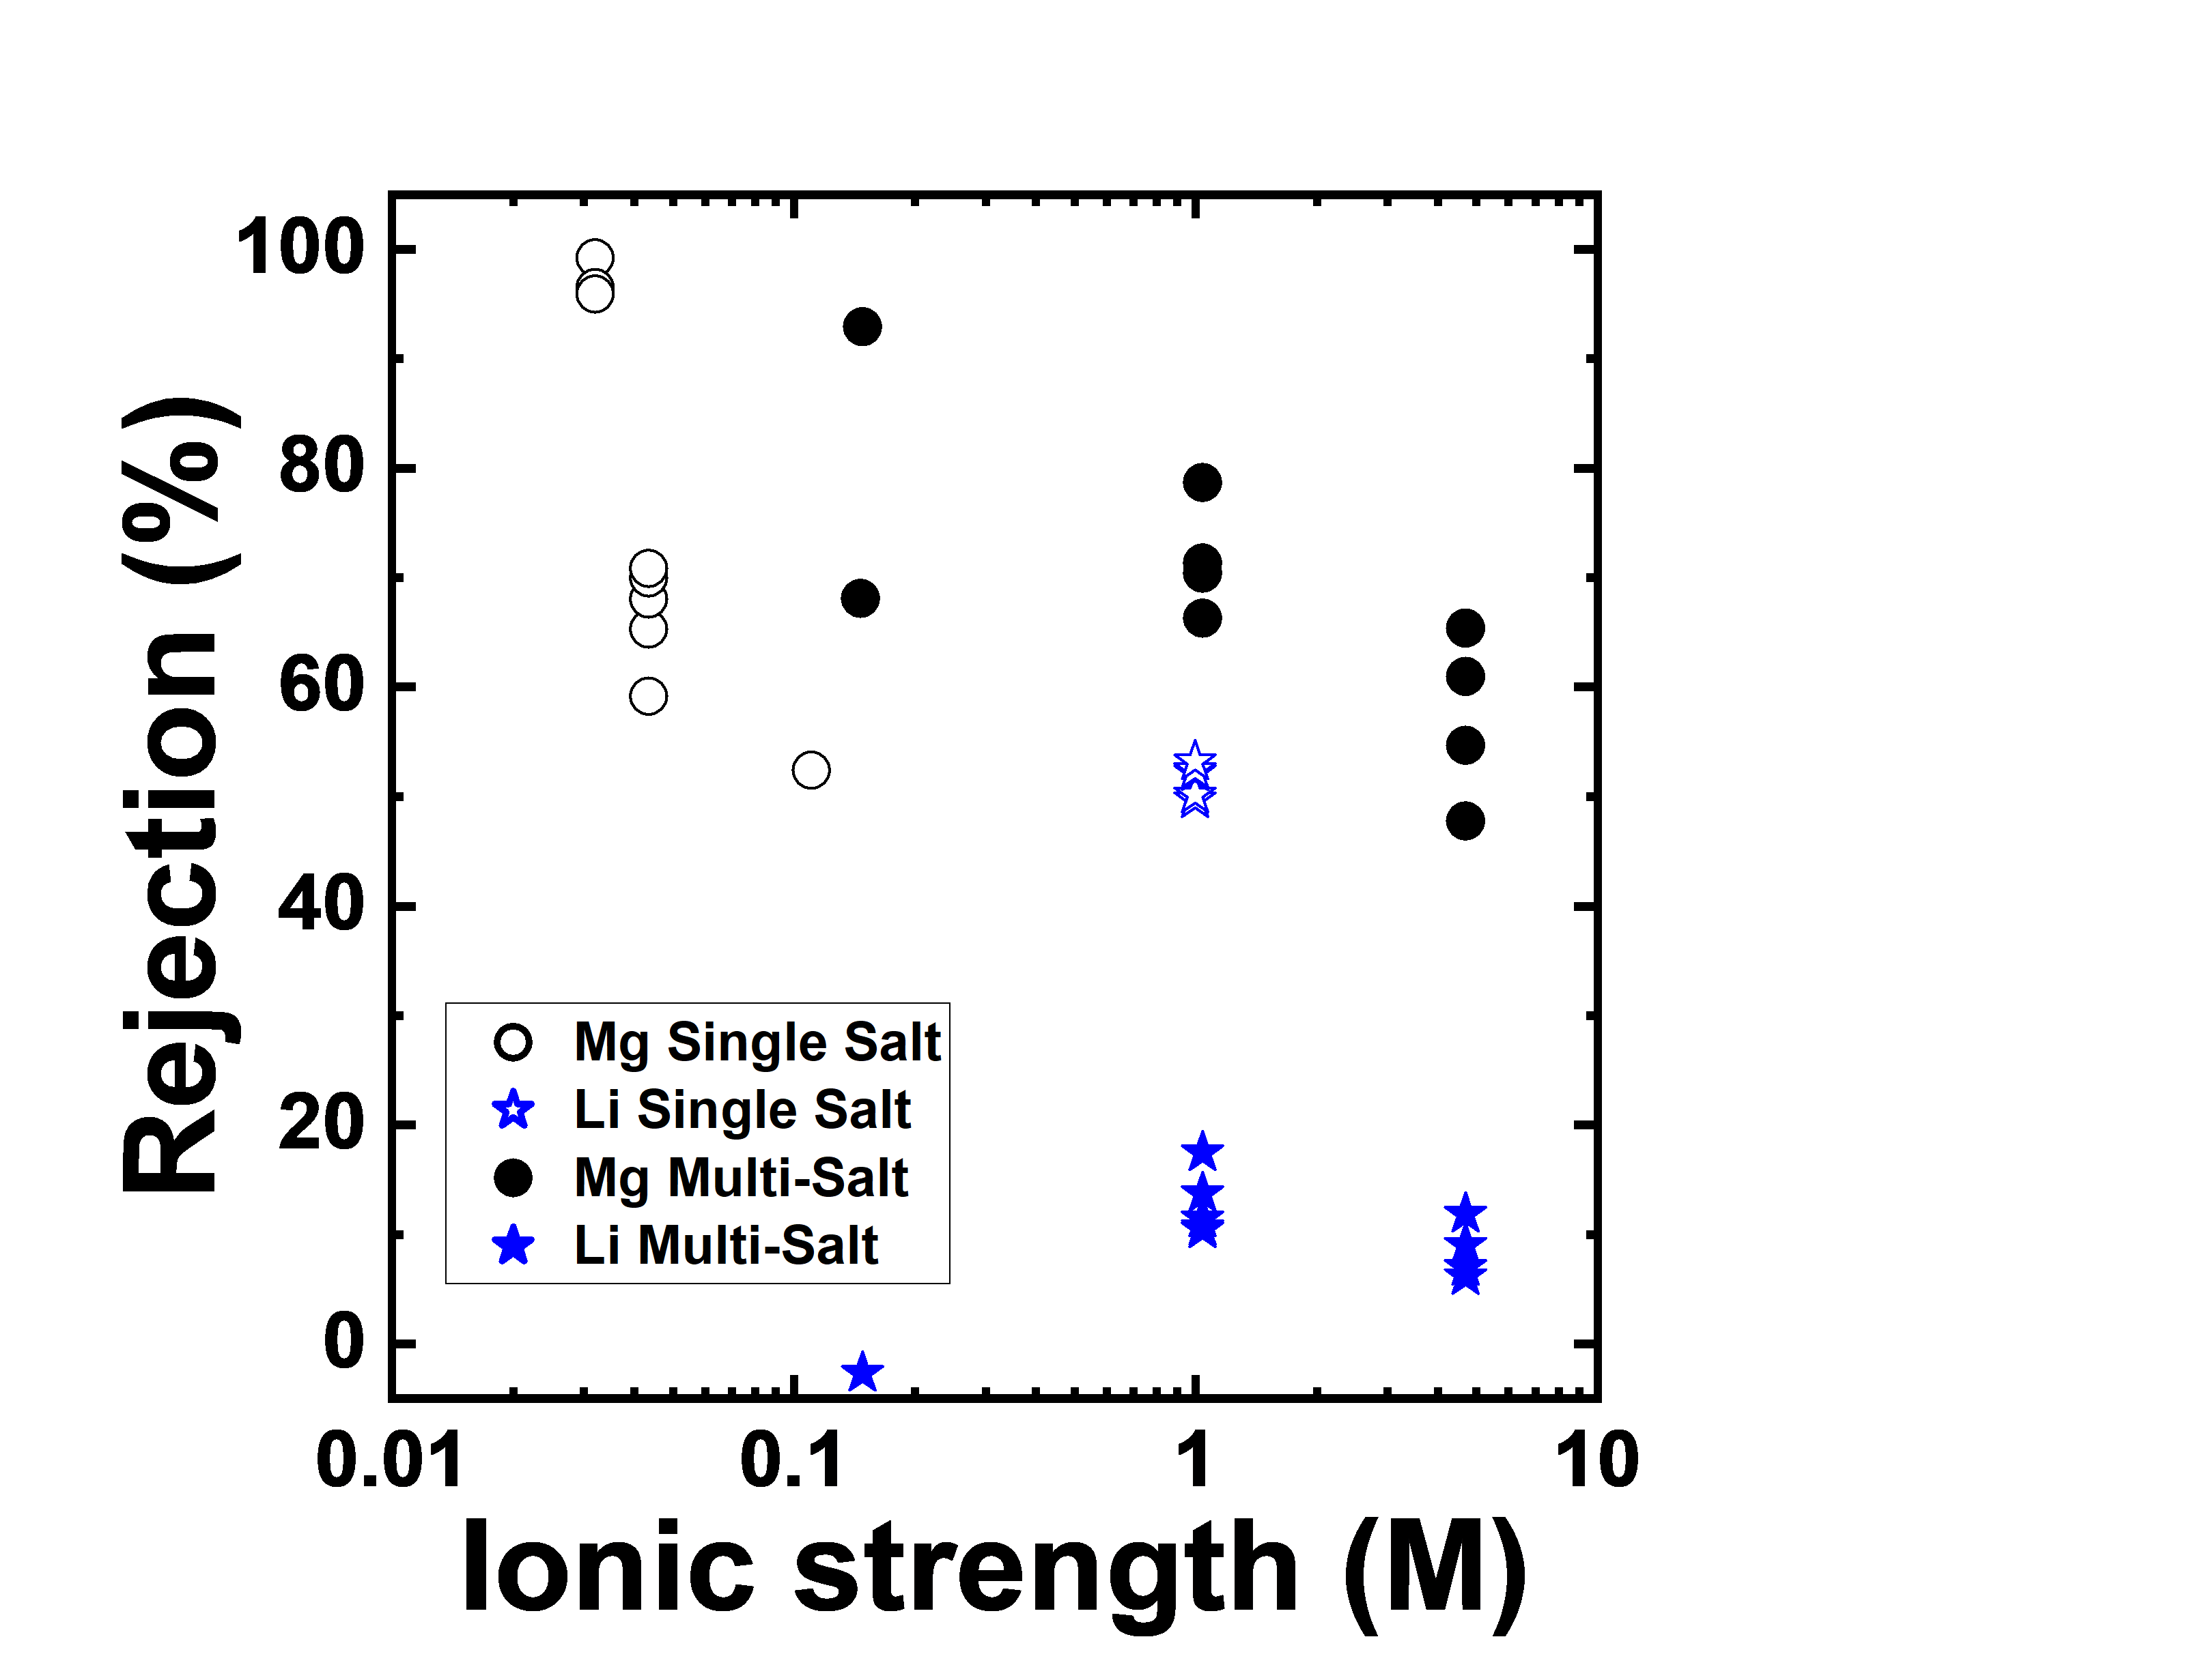
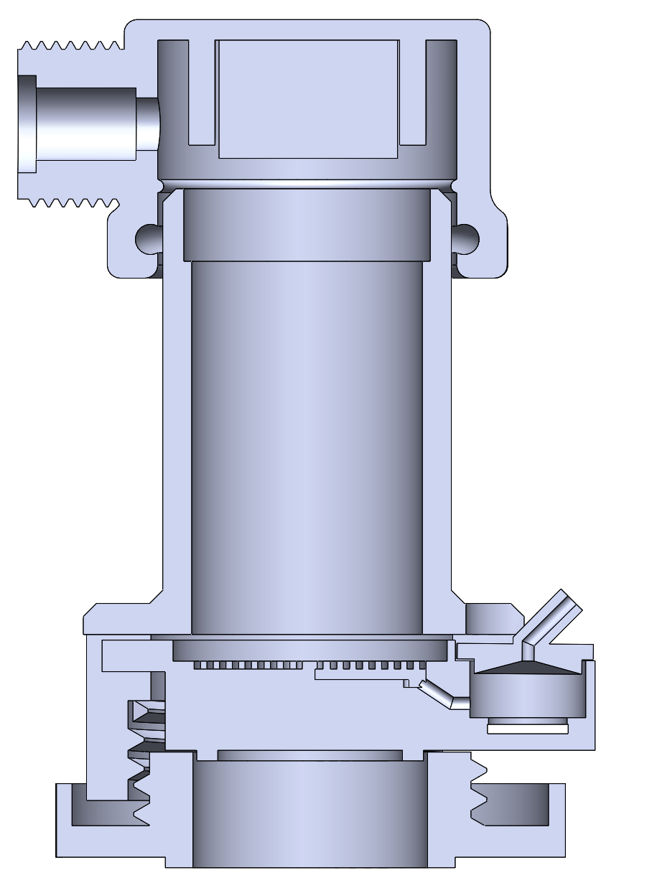
Diafiltration Capabilities Will Provide an Edge on Understanding Fundamental Phenomena that Govern Multicomponent Transport
Membrane
Permeate Outlet
Retentate Probe
Stir Bar
Permeate Probe
Systematic studies on multicomponent interactions are lacking.
Now, diafiltration enables ‘continuous’ monitoring of retentate and permeate measurements.
3000 µS cm⁻¹
450.0 µS cm⁻¹
Conductivity Boards
Lair et al. Annual Reviews

Slide 3
Overarching Questions
What ionic strength/ion ratios do multicomponent interactions begin to occur?
How does membrane nanostructure (i.e., charge density) effect multicomponent interactions?
How can
Lair et al. Annual Reviews

Slide 4
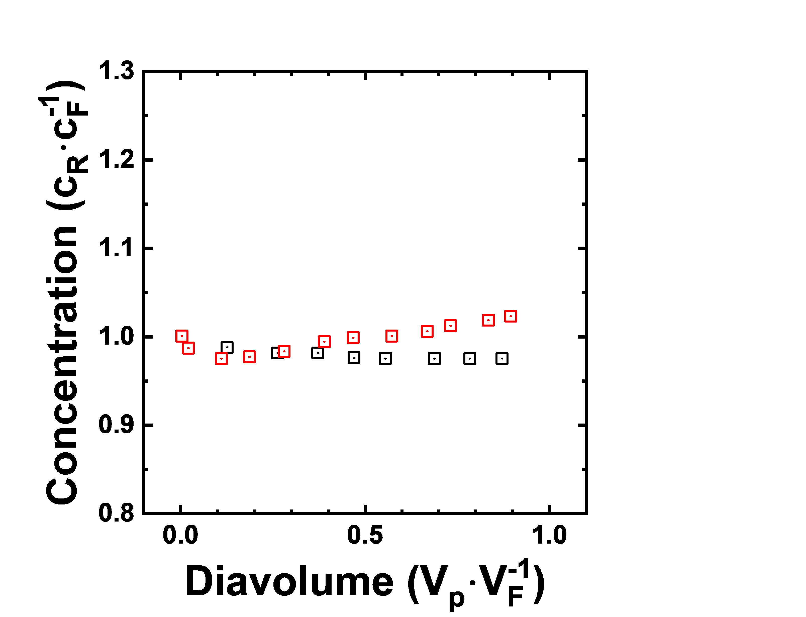
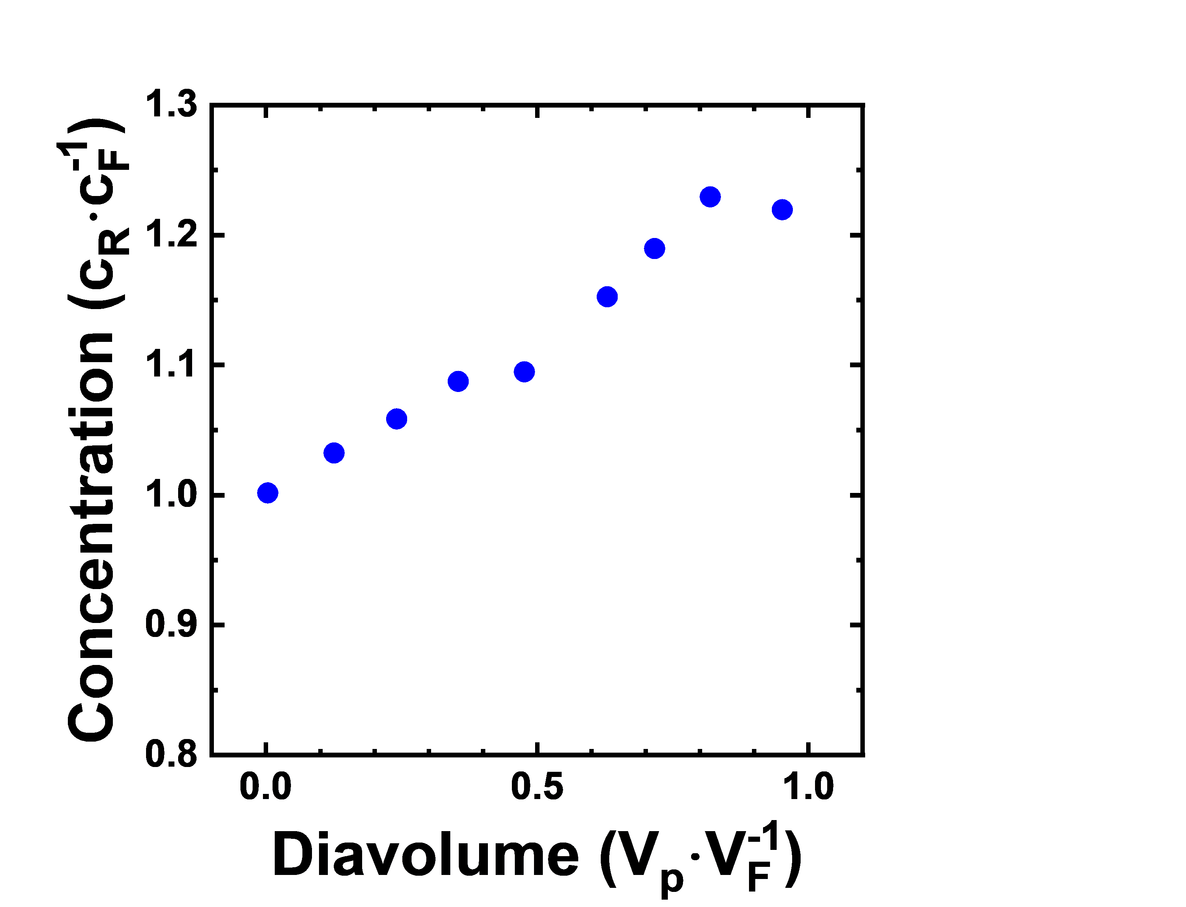
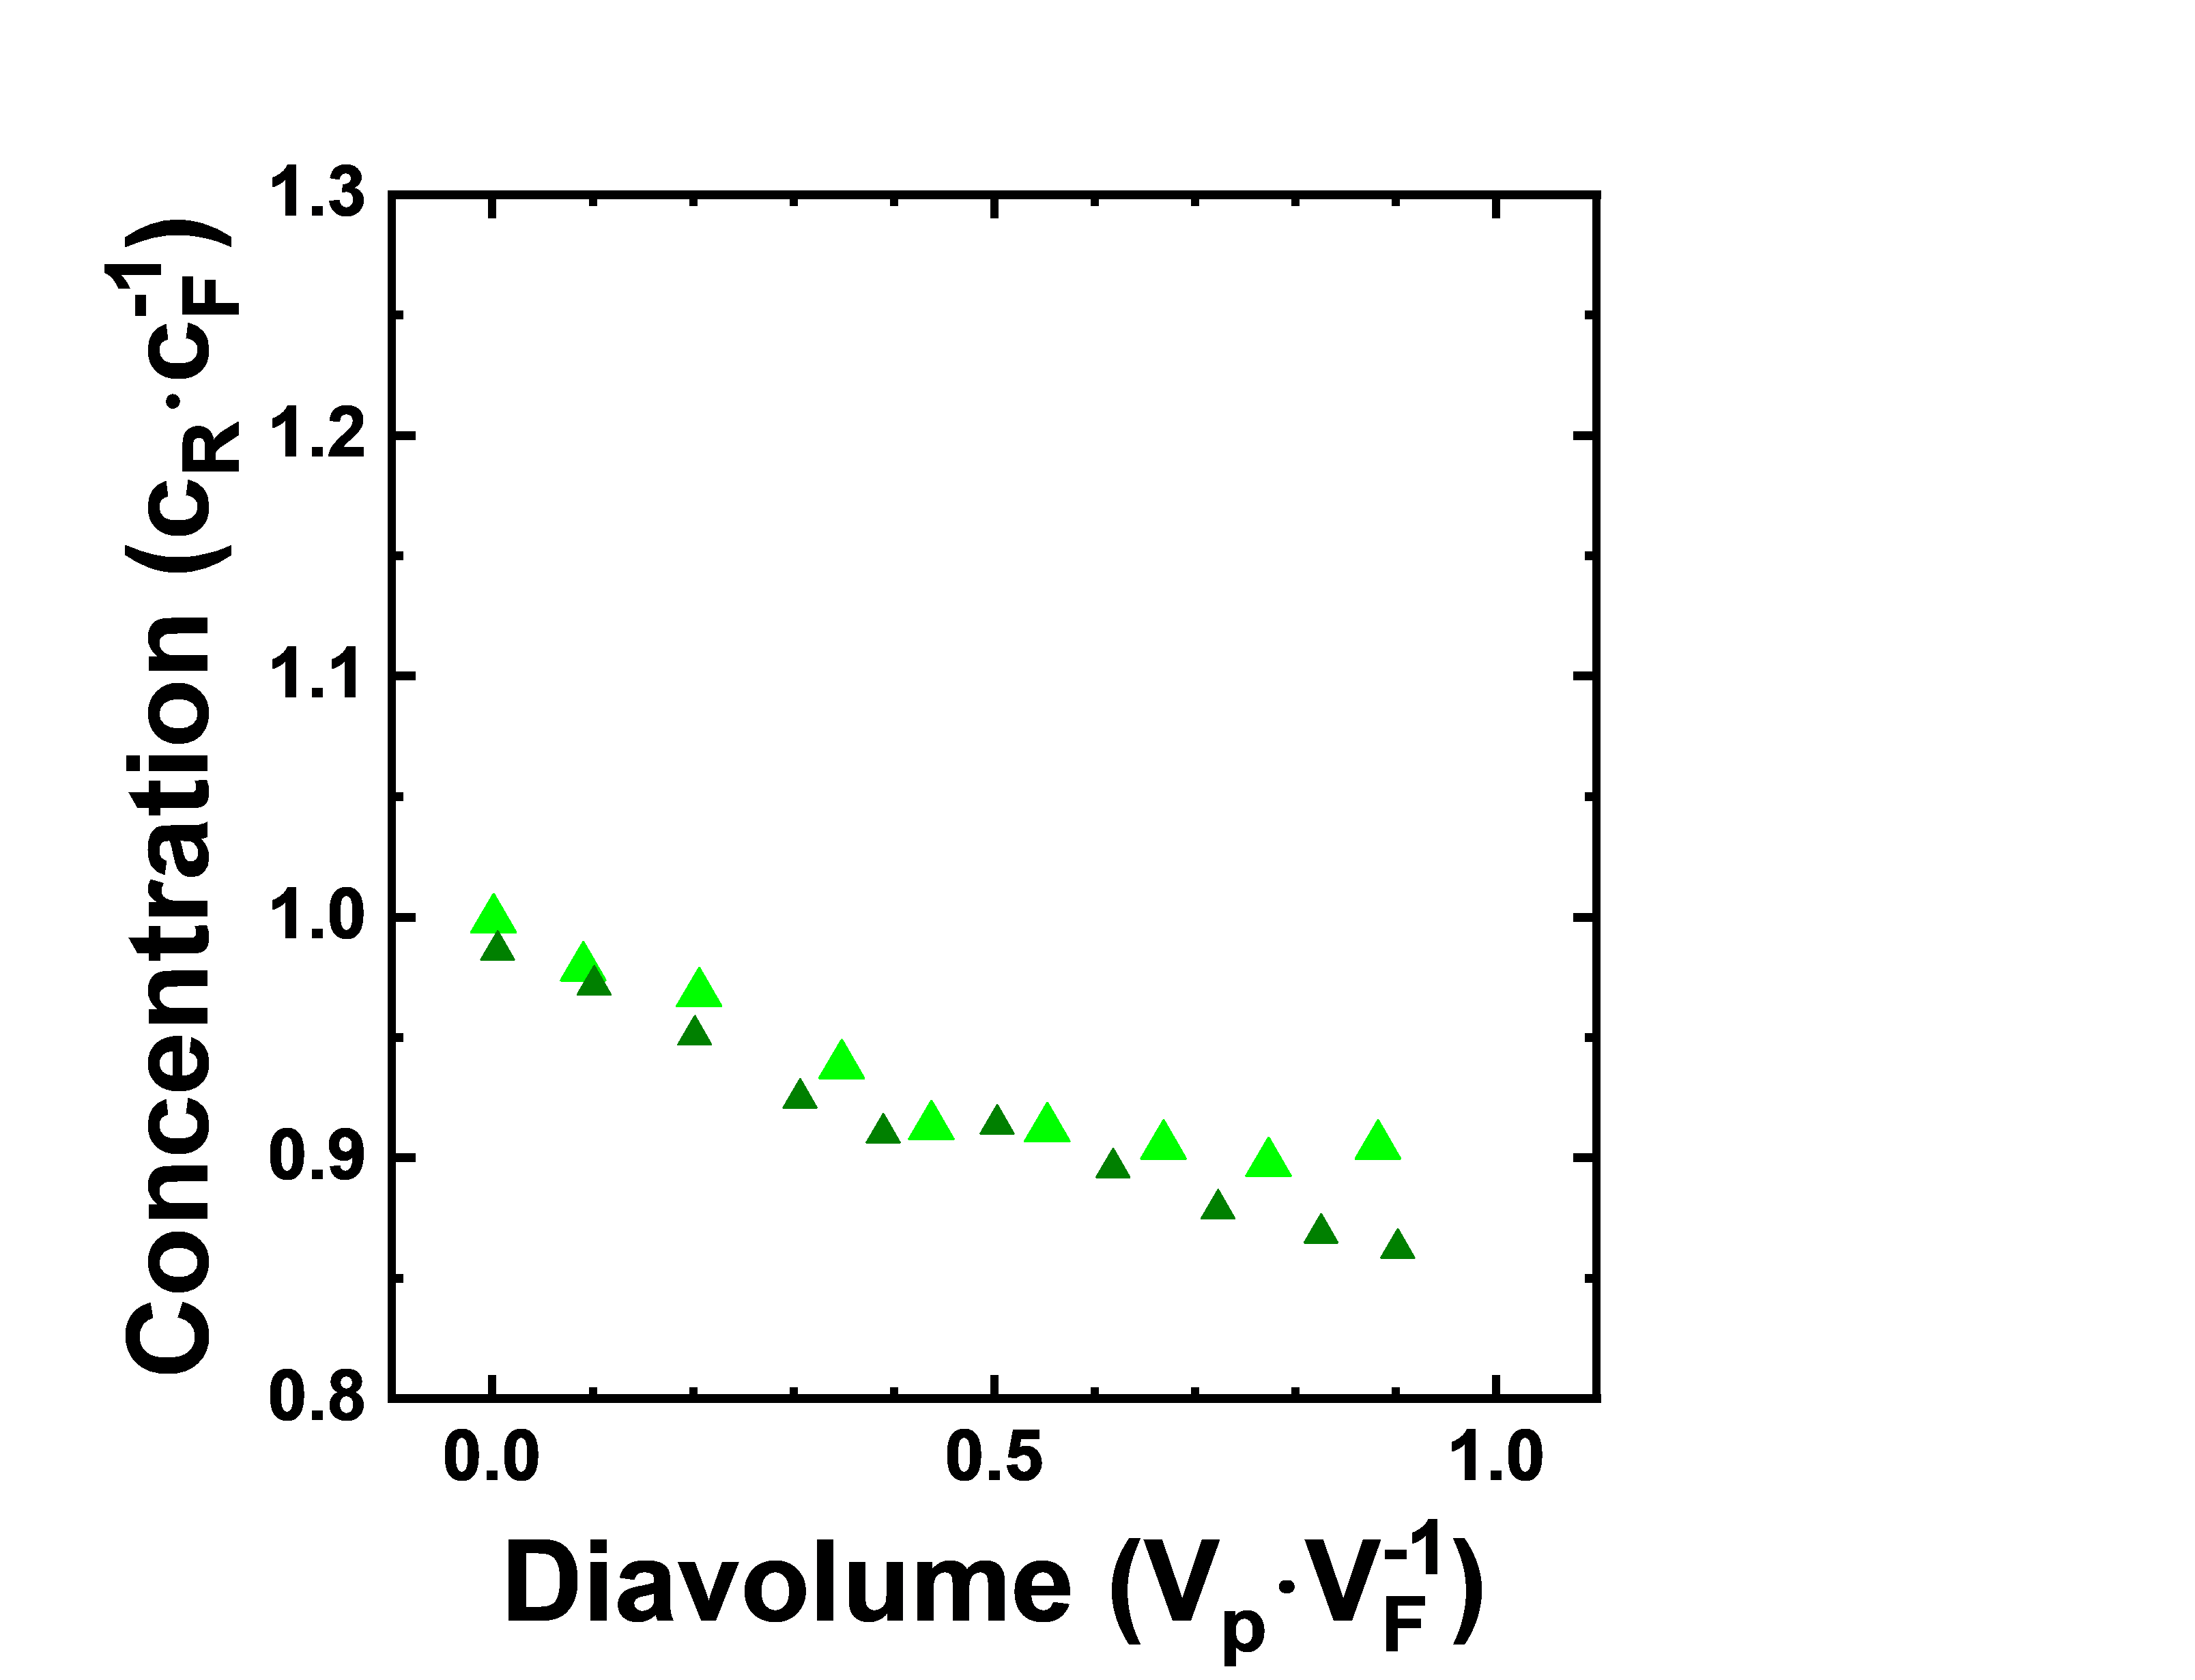
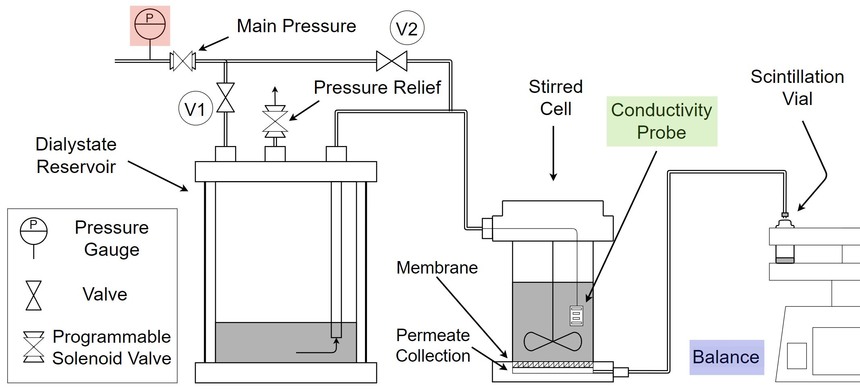

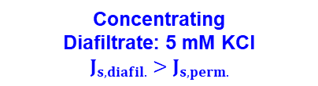



Diafiltration can Operate in Three Distinct Regimes
NF90 Membranes, Solute: KCl
Concentrating
Diafiltrate: 5 mM KCl
$$J_{s,diafil.}>J_{s,perm.}$$
Critical
Diafiltrate: 1.5 mM KCl
Diafiltrate: 1.8 mM KCl
$$J_{s,diafil.}=J_{s,perm.}$$
$$J_{s, diafil.}$$
Diluting
Diafiltrate: 0 mM KCl
$$J_{s,diafil.}<J_{s,perm.}$$
$$J_{s, perm.}$$
Ouimet, et al., J. Membr. Sci., 2022
Kilmartin et. al., I&EC, 2021.
Notes:
Change plot to be the amount of solution that permeated.
Concentrating Regime – Diafiltrate: 5 mM KCl
Critical Regime – Diafiltrate: 1.5 mM KCl (black), 1.8 mM KCl (red)
Diluting Regime – Diafiltrate: 0 mM KCl

Slide 5
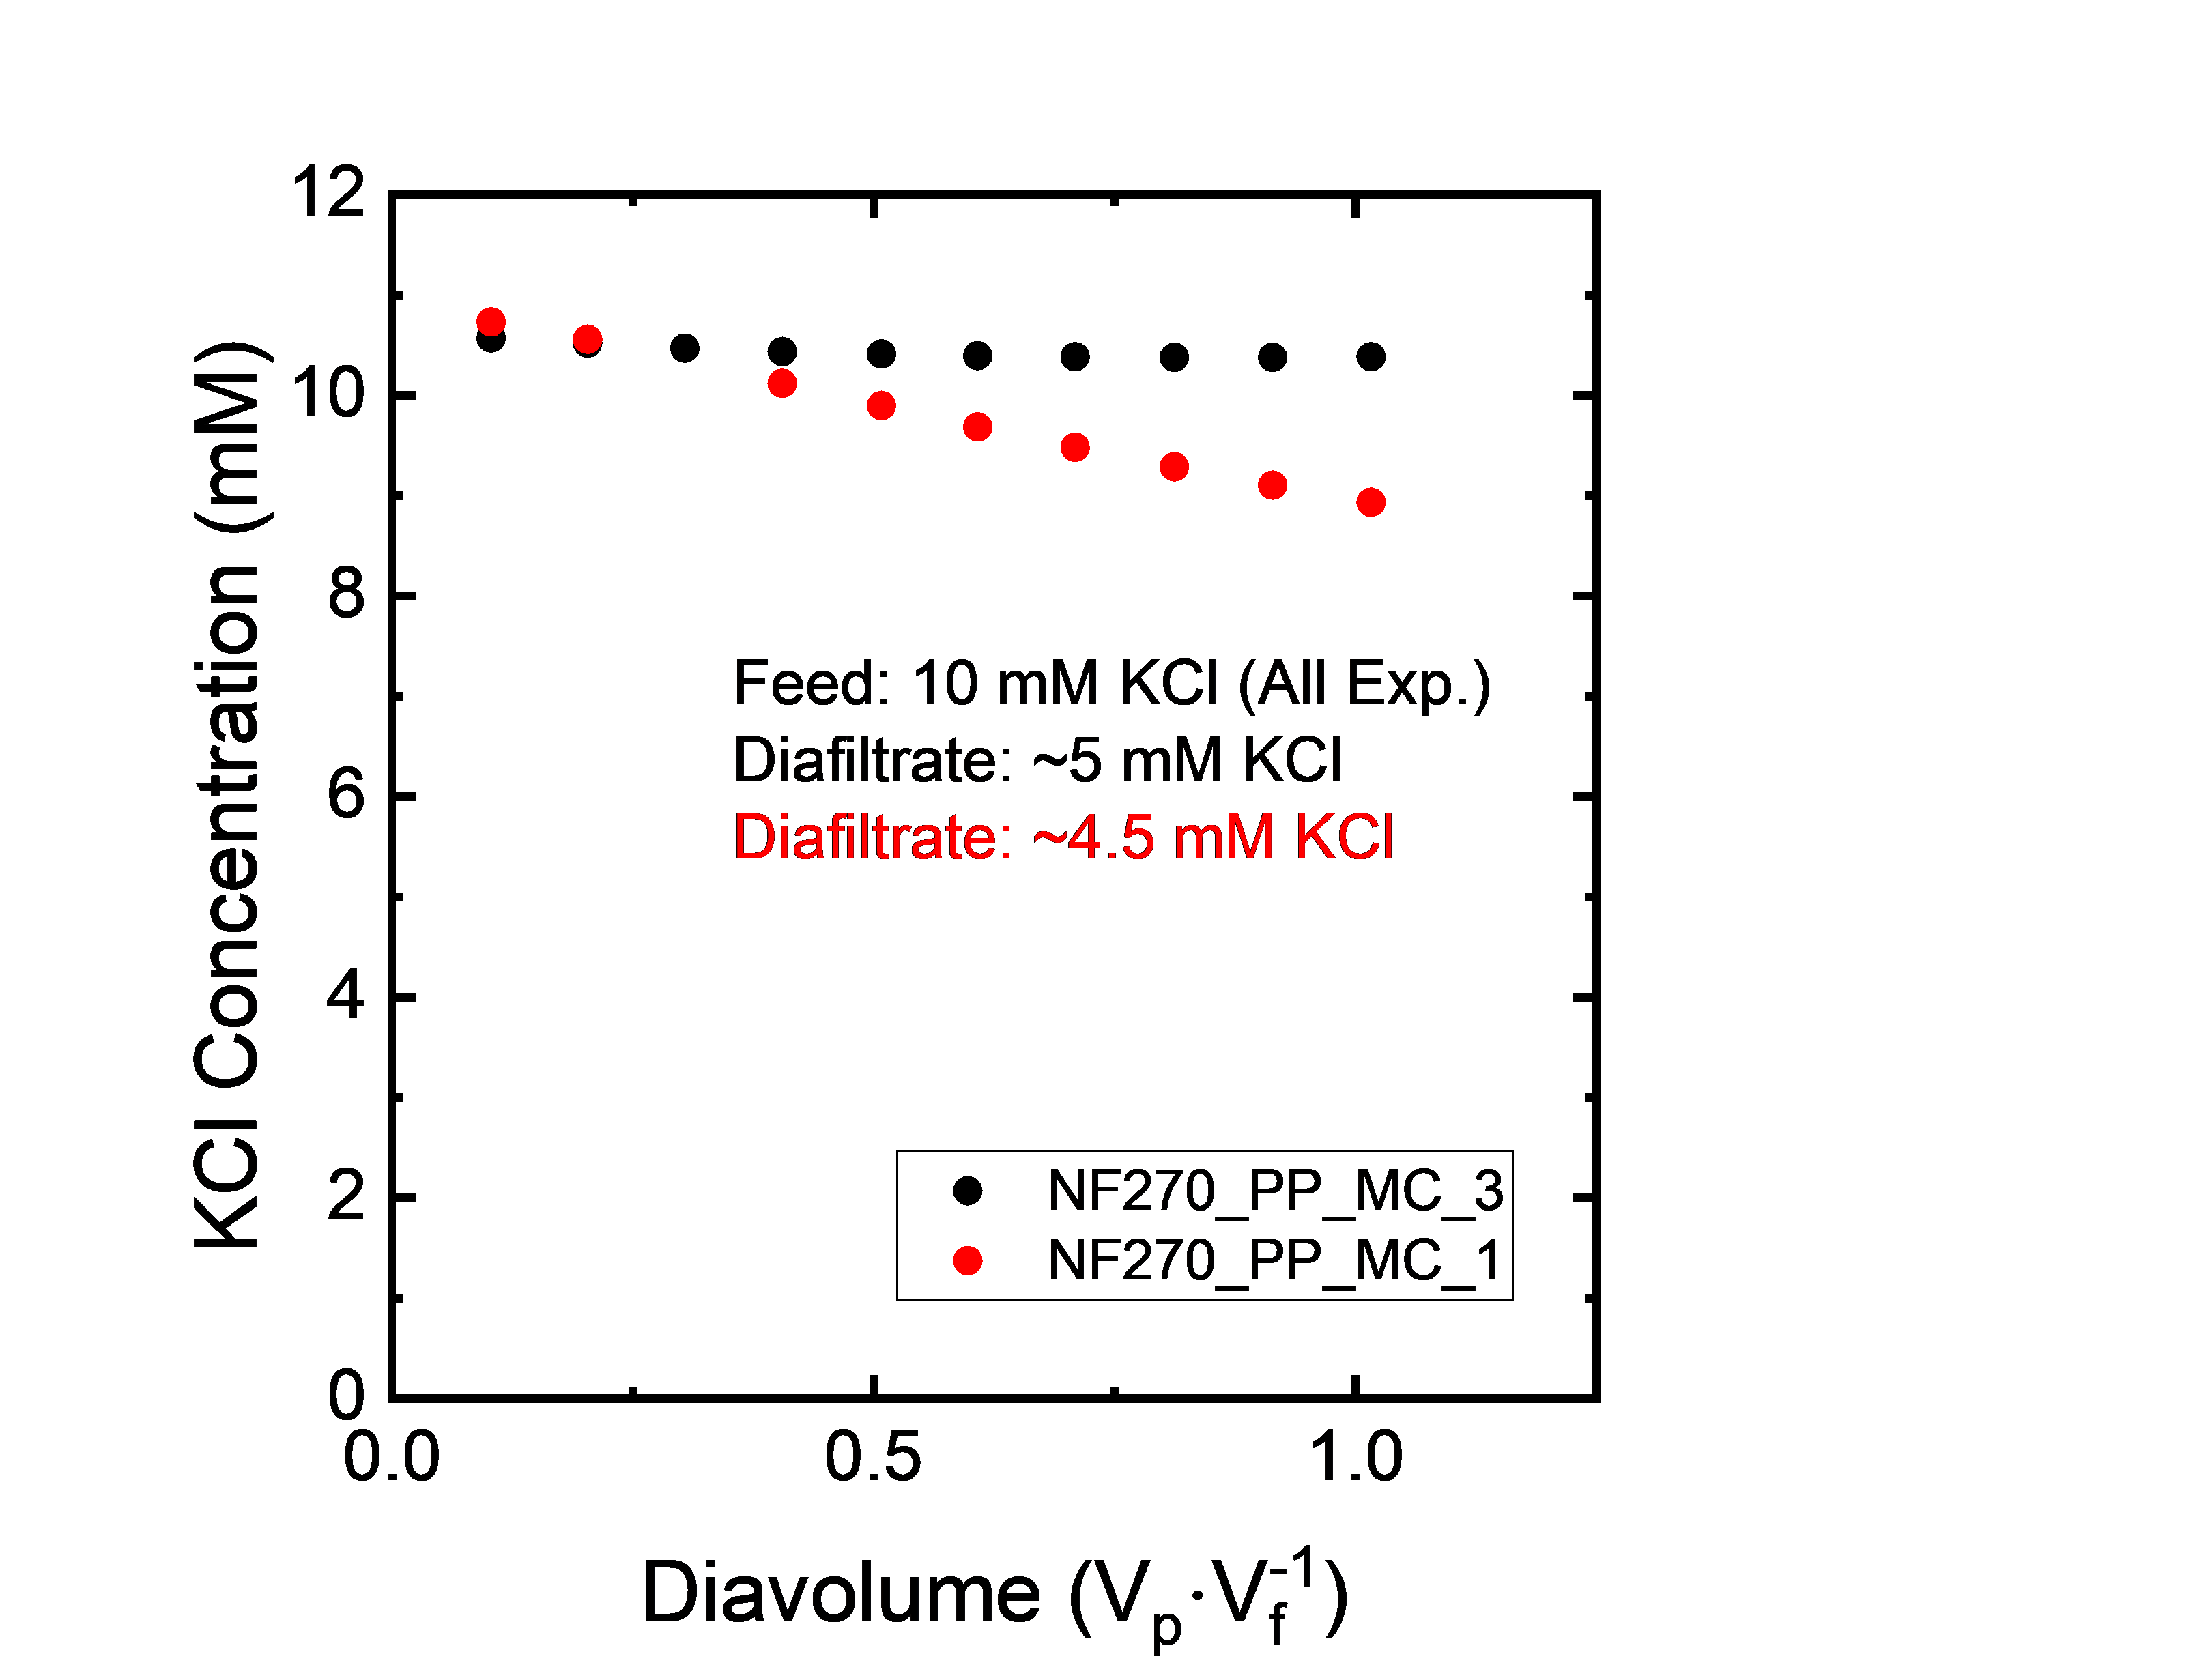
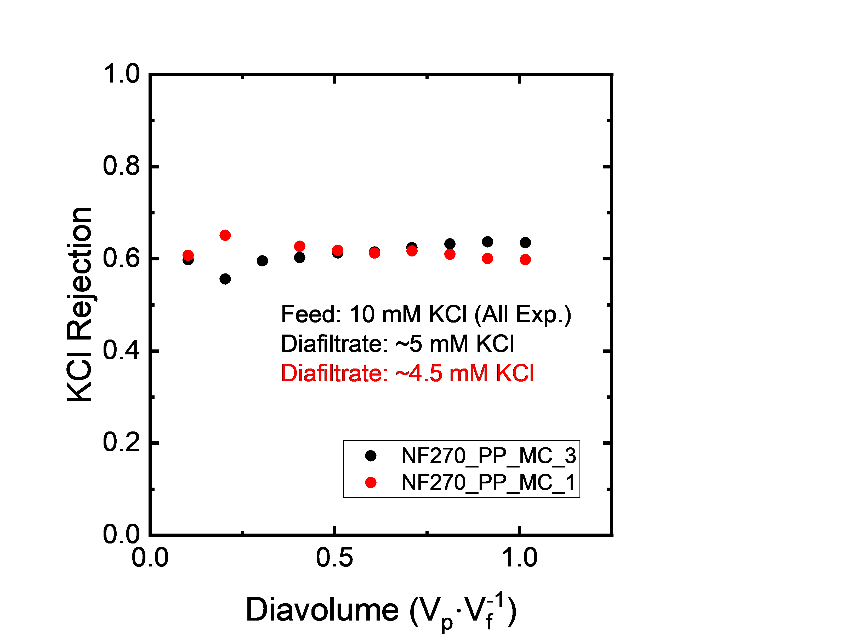
Single Component KCl Experiments

Slide 6
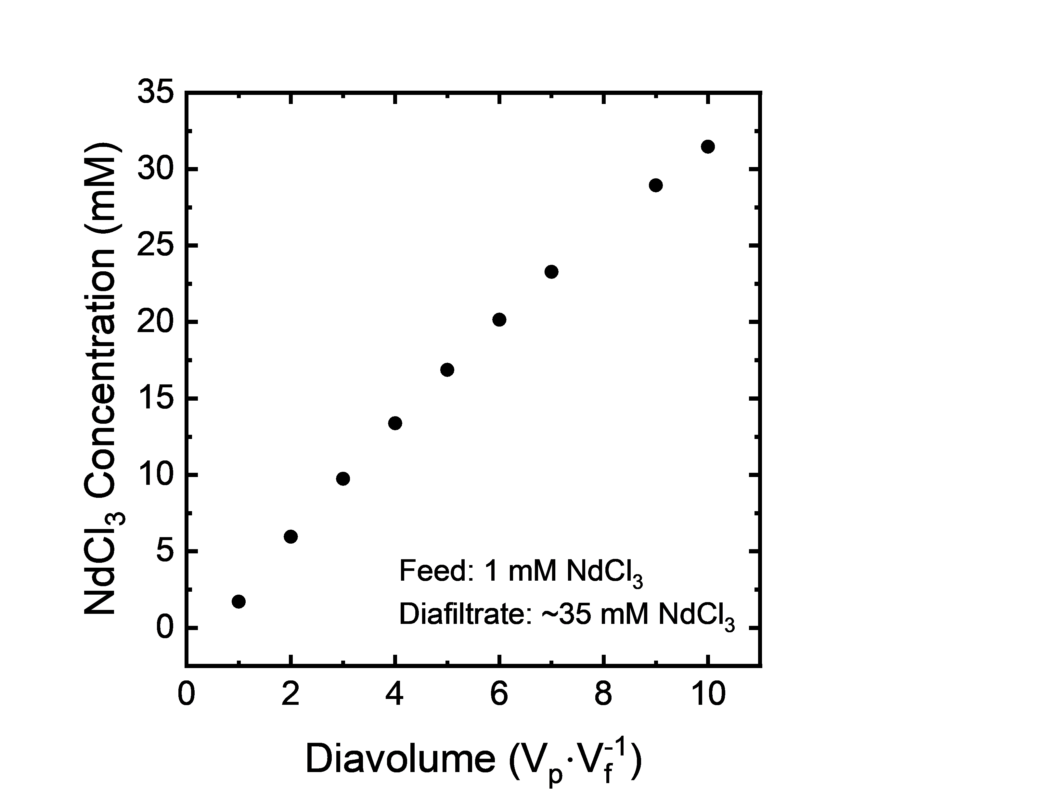
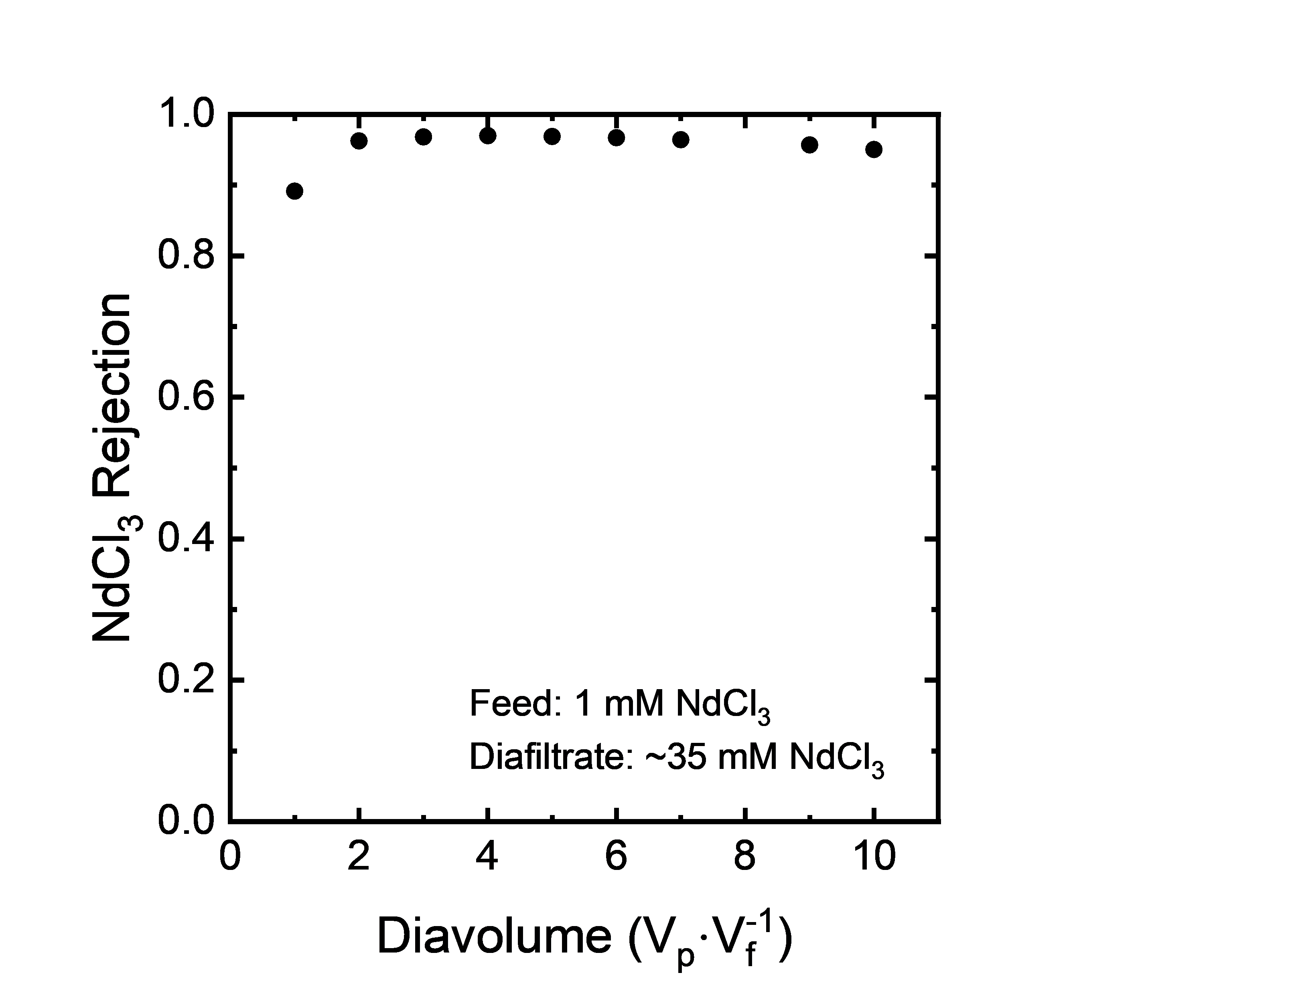
Single Component NdCl₃ Experiments

Slide 7
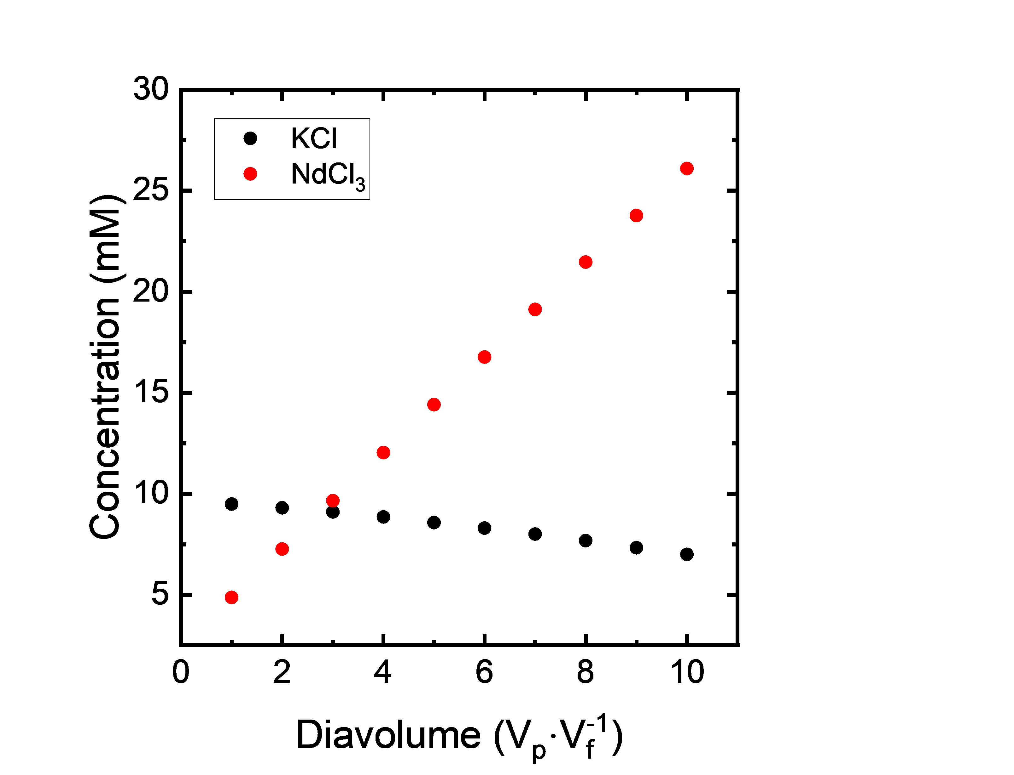
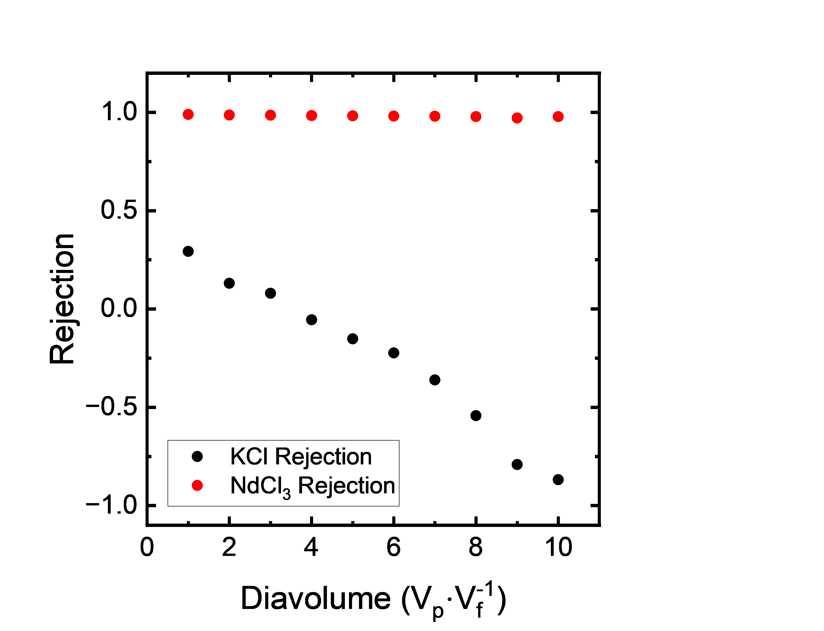
Multicomponent KCl, NdCl₃ Experiments
Feed: 10 mM KCl, 0 mM NdCl3
Diafiltrate: 5.5 mM KCl, 30 mM NdCl3

Slide 8
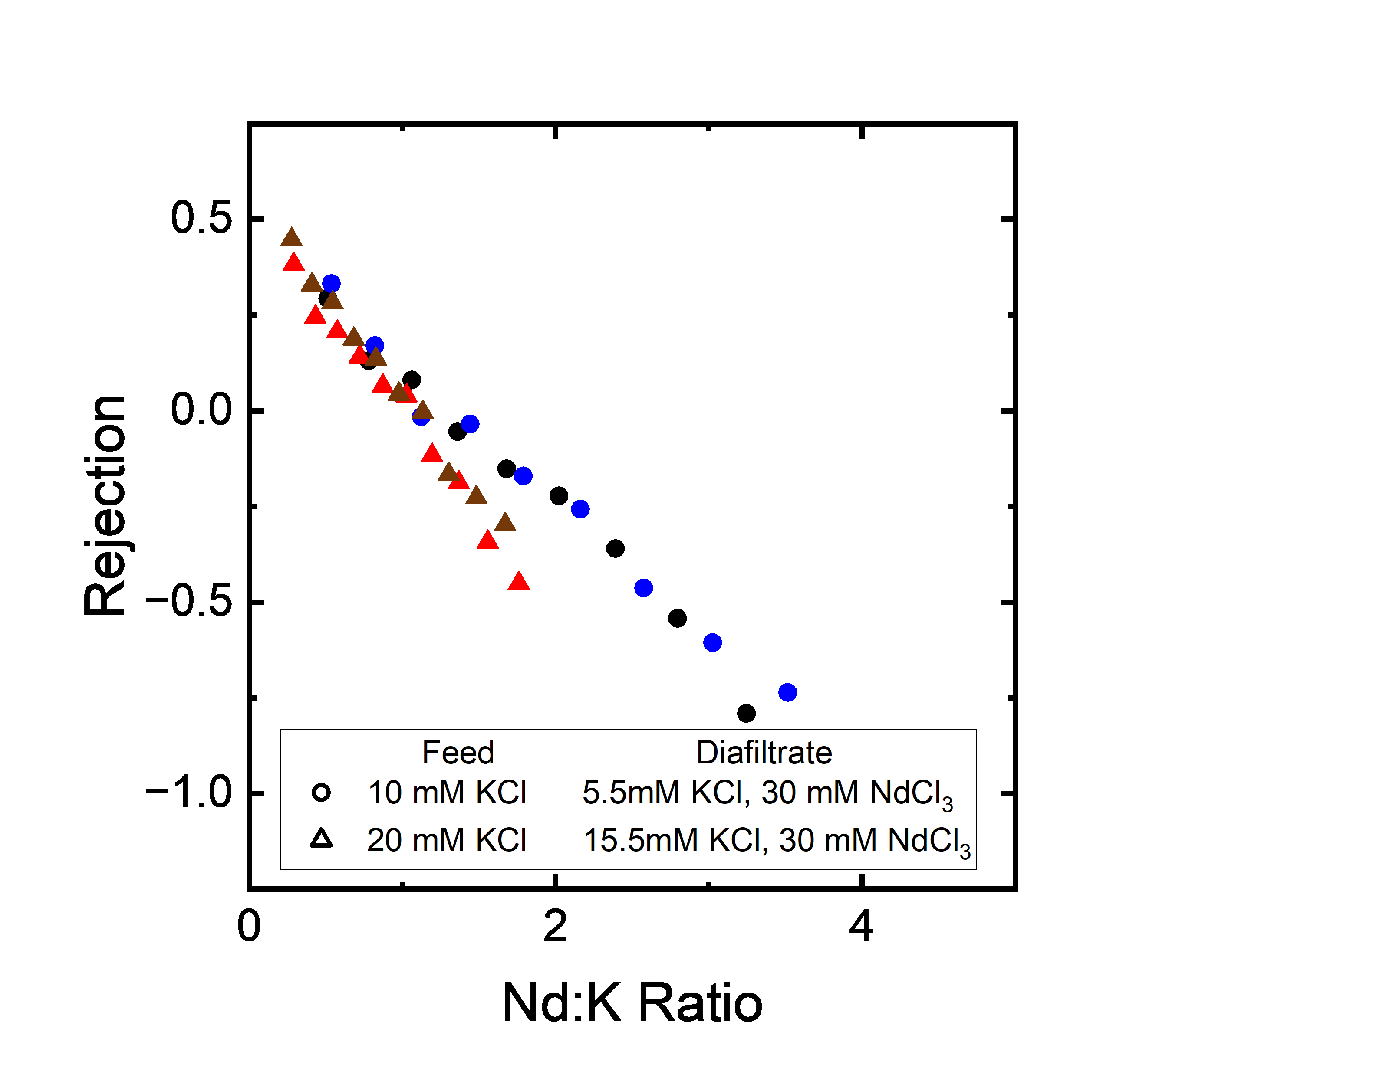
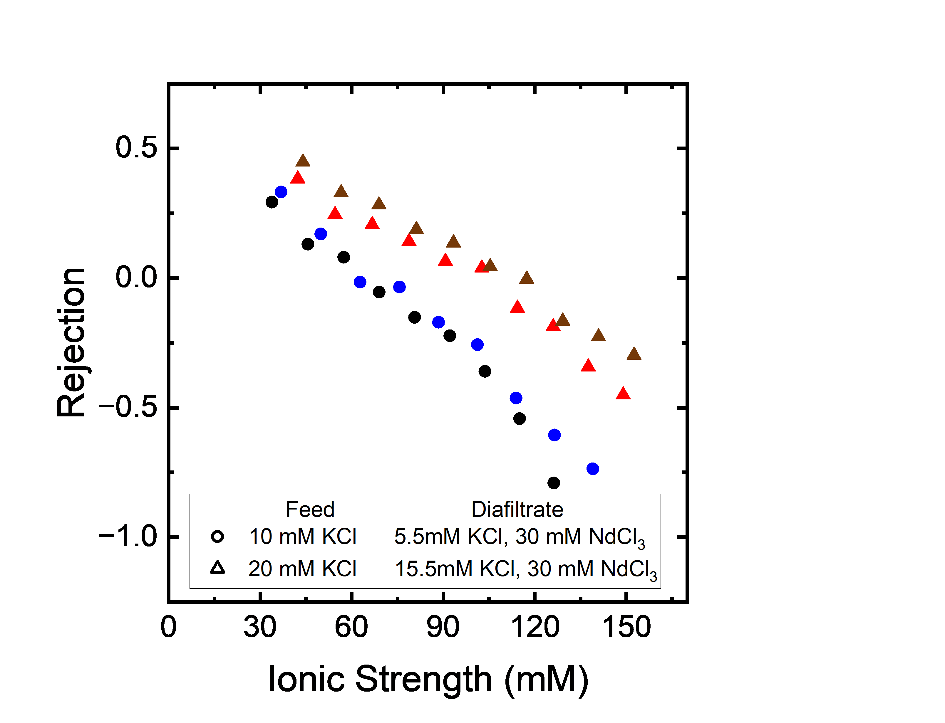
KCl Rejection is More Strongly Dependent on Ionic Strength than KCl:NdCl₃ Ratio

Slide 9
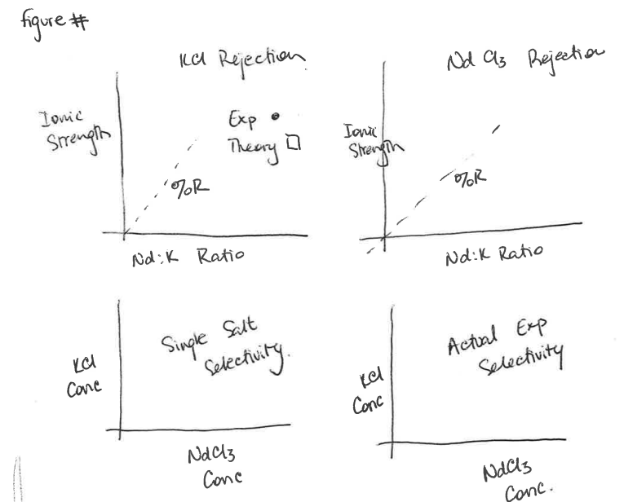
Likely not the first figure, but displaying information in this way creates a figure that is ‘extremely’ information dense.
* Figure will likely hold continuous diafiltration data from ~6 unique experiments, providing ~ 10⁴ data points.
Can we ‘break’ down this data to validate/generate equations on
The molecular scale to enable reverse engineering of membrane materials (rejection as a function of transport coefficients)?
The systems scale to inform modular membrane design. (Rejection as a function of species/salt concentration)

Slide 10
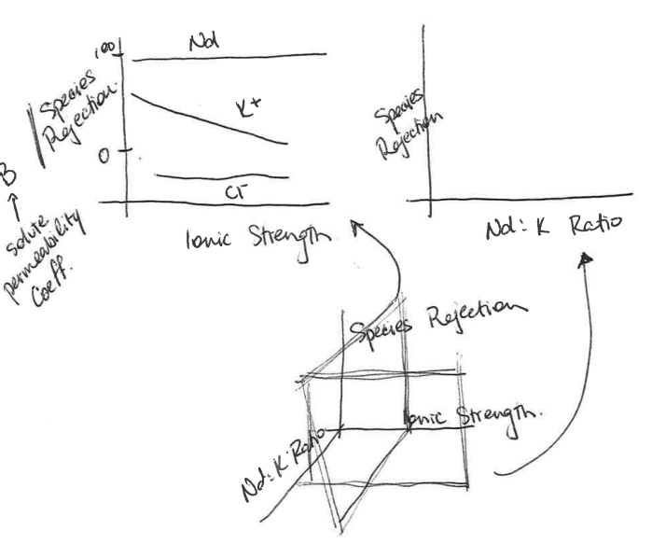
Similair to previous graph yet aims to be ‘easier’ to understand.
The 3D graph is broken up into slices that are ‘exploded’ in the upper panels. Currently, most data is shown as 2D plots, yet we hypothesize that this removes a significant amount of important information that explains when multicomponent interactions are important.

Slide 11
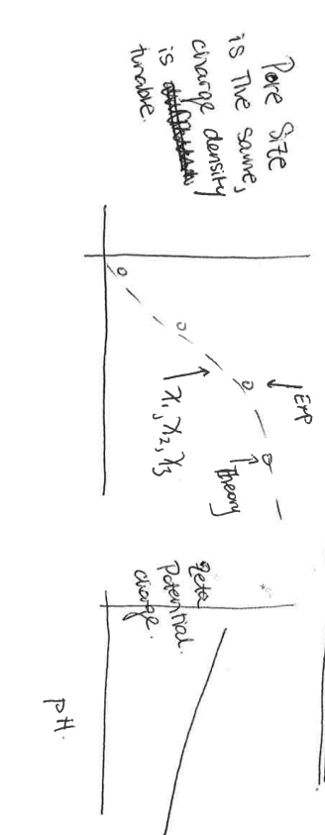
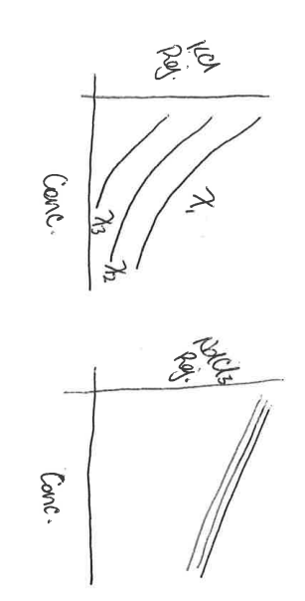
While an experimentalist engineered 6 unique experiments to characterize membranes (how much information is generated), theory/modeling can propose # experiments to generate # more information.
Synthesize 3 copolymer membranes with different charge densities.
Show… Pore size is constant, charge density is tunable. Characterize copolymers using suggested experiments.
Notes:
Can this be explored by changing the salt identities instead of the

